Slide 1

Introduction to Multimodal AI
Course Title: Multimodal AI
Course Code: AAI3031-01
Dr. Khan Muhammad (칸무하마드)
Associate Professor
Department of Applied Artificial Intelligence
Sungkyunkwan University
Email: khanmuhammad@g.skku.edu

Slide 2
Content List
Course Information
Course Materials
Students’ Assessment
Contact Instructions
Course Rules/Regulations
Professor’s Bio and Team
Research Topics
Understanding AI
  Intelligence starts with the world
  What is Artificial Intelligence?
  Intelligence in Machines: Rules vs Learning
  The basic idea of an AI system
Multimodal AI
  The real-world problem
  Why Multimodal AI?
  What is Multimodal AI?
  Understanding “Modality”
  Why are Modalities different?
  The Multimodal Pipeline
  The three core concepts
  Application Landscape
  Course Case Studies
  Course Learning Outcomes
  Course Roadmap
10. Goals and Expectations
11. Assignment/Project/Presentation
2

Slide 3

1. Course Information
3 Credits [Flipped Learning (1 hour online/recorded, 2 hours offline)]
  Lectures: 3 hours weekly
    Room: International Hall Multimedia Lecture Room (9B217)
      Thursday 15:00 to 15:50 PM
      Thursday 16:00 to 16:50 PM
      Total: 1 Hour, 40 min.
  Type: Theory/practical/invited speeches/Recorded/online/in-person
  Attendance
    “SKKU-Attend” for attendance, absence and late rules
    Default setting for the time being
    Zoom/Manual
3

Slide 4
2. Course Materials
  PDF/PPT of slides
  The slides will be available on i-Campus of SKKU
  Sometimes the slides will be updated later.
  Recorded videos/lectures will be available on i-Campus (Lecture Contents)
  Some more references and links for lectures notes may be given time to time
  Tools
    Depending on the assigned project, you will have choice to select language/toolkit/frameworks (s):
      Python, C++
      MATLAB, Julia
      PyTorch, TorchVision, OpenCV etc.
4

Slide 5

3. Students’ Assessment
  Attendance: 10%
  Mid-term exam: 20%
  Final-term exam: 40%
  Practice Assignment (PA)/Quizzes/Homework etc.: 15%
  Presentation: 15%
  Project
    Multimodal AI and your major related project completion
    Survey/Research articles
  Subjective
    Short-answer essay
    Extended-response essay
    Problem solving
  Cheating/Copy Paste Policy
    Automatic F for both
5

Slide 6
4. Contact Instructions
  E-mail (Preferred)
    khanmuhammad@g.skku.edu (preferred)
    khanmuhammad@skku.edu
    Information needed (in English)
        Subject of the Email
        Student Name
        Student ID
        Email’s Content/Query/Question/Feedback/Suggestions etc.
  Office
    International Hall, Room # 90326
    A prior appointment through e-mail is required (extremely serious matters)
    Online Zoom/Google Meet meetings can be arranged with flexibility.
  TA
    Wajahat, Master Student (wajahatullah@g.skku.edu)
6

Slide 7
5. Course Rules/Regulations
  Assignment/Homework via e-mail is not encouraged (exceptional).
  Assessment rubrics will be followed to evaluate assignments/projects and exams (depending on the need).
  University/Department rules and regulations must be followed.
  More: Will be explained from time to time
7

Slide 8
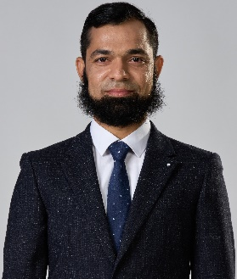
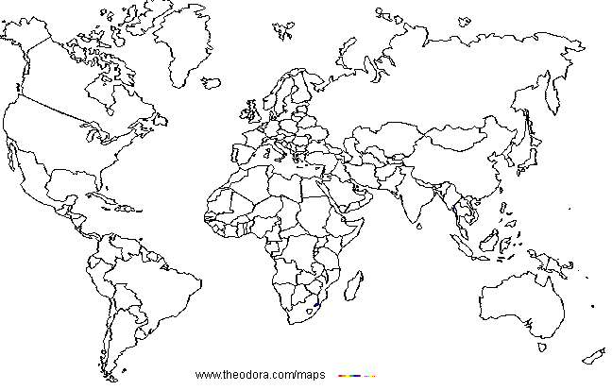
6. Professor’s Bio
Khan Muhammad (Senior Member, IEEE)
Research Interests
  Associate Professor (Tenure-Track), SKKU, Korea
  khanmuhammad@skku.edu
  +82-10-4831-2104
  Editorial Board Member, 7 Journals
  Area/Associate Editor, 7 Journals
  Top 2% Researcher (Stanford Uni. List), 2020-present
  #2 in Korea (Best CS Scientists 2026, Research.com)
  HCR (top 1%), 2021-2024
  Computer Vision
    Activity Recognition (Normal, Child Hazards, Aggression, Bullying)
    Image Enhancement (Low-light, Dehazing, Denoising)
    Person Re-identification
  Large Language Models (LLMs)
    Sentiment Analysis
    Hallucinations
  Intelligent Surveillance
    Fire/smoke detection, segmentation and scene analysis
    Unexpected Road Hazards Detection and Analysis
Publication Record
Over 300 articles/papers
Conferences and Workshops
2020
Indonesia, Singapore
2026
Spain, US, Finland, Brazil, Uk, Japan
180+
As lead-author (1st or corresponding author)
2024
Canada, Australia, India, Italy, Vietnam
As co-author
90+
2022
USA
Total citations (Google Scholar)
32230+ (H-Index: 93)
2025
Turkey
Impact factor
1750+
2016, 2017
Pakistan
2016,2017
Jeju, Busan Korea
15
Patents Record (Korean, US mainly)
2019
Thailand
2017
Taiwan
15
Participation in Research Projects
2021
China, Spain
2018
Vietnam
2021
France
10+
Professional and Research Experience
8

Slide 9
6. Research Team (Major Collaborations)
Wuhan Textile University, Hunan Normal University, China
Brain AI Lab,
KNU, Korea
Visual Surveillance Lab, NIT, India
VIS2KNOW Laboratory, SKKU
DIP Lab, ICP, Pakistan
ANU/UWA, Australia
TECNALIA, Spain
9

Slide 10






6. Research Team
Prof. Sung Wook Baik
(Supervisor, Sejong University, South Korea) [March 2015-Feb. 2019]
Prof. Muhammad Sajjad (Academic Mentor)
NTNU, Norway and ICP, Pakistan)
Prof. Irfan Mehmood (Collaborator)
University of Bradford, UK)
Prof. Jamil Ahmad (BS Supervisor & Collaborator)
Islamia College Peshawar, Pakistan)
MBZUAI, UAE
Abdul Malik Badshah (Master) [Industry]
PhD Fellow, University of Missouri–Kansas City, USA
Noor Ullah (Master) [Industry-Dabeeo, Korea]
Nasir Rahim (Master) [Industry + SKKU]
PDF at University of Michigan, USA
10

Slide 11
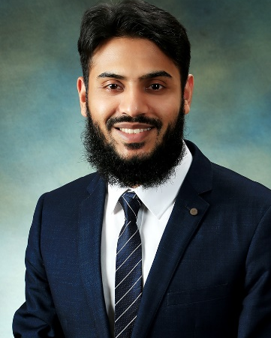

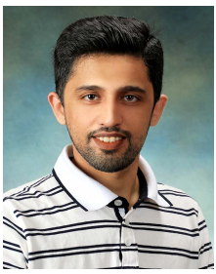
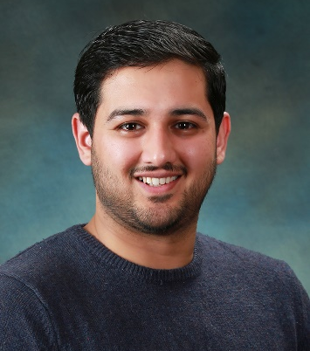
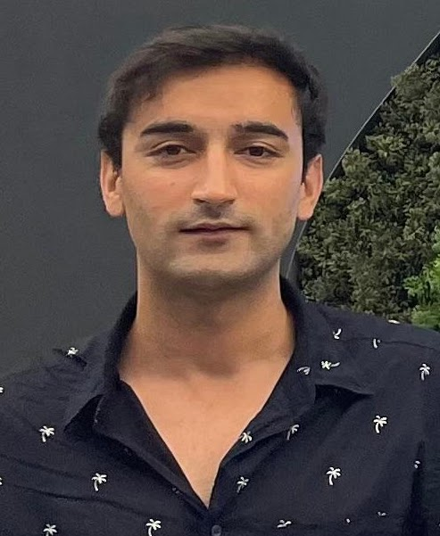
6. Research Team (Alumni)
Dr. Amin Ullah
(Joint Master & Ph.D, SJU, South Korea)
[PDF at Oregon State University, USA]
[Senior AI/ML Engineer at Boeing Research & Technology Software, USA]
Dr. Ijaz Ul Haq
(Joint Master & Ph.D.) (2017-2022), SJU
[PDF at Oakland/Michigan University, USA]
Dr. Tanveer Hussain
(Joint Master & Ph.D.) (2017-2022), SJU
[PDF at University of Leeds, UK]
Lecturer at Edge Hill University, UK]
Dr. Salman Khan
(Master, SJU, South Korea, PhD, Orford-
Brookes University, UK)
[PDF at Oxford Brookes University, UK]
Dr. Fath U Min Ullah (Joint Master & Ph.D.)
(2017-2023), SJU, South Korea
[PDF at University of Sheffield, UK]
Lecturer, University of Central Lancashire, UK
Dr. Nasir Rahim (Master, SJU)
[Industry + SKKU (PhD)]
PDF, University of Michigan, USA
11

Slide 12



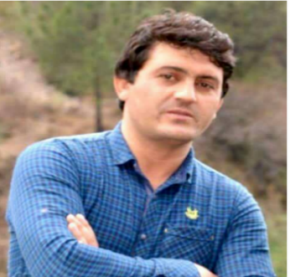



6. Research Team (Mix)
Dr. Waseem Ullah (PhD, 2019-2024, SJU)
PDF, MBZUAI, UAE
Dr. Samee Ullah (Ph.D.) (2019-2023)
SJU, South Korea
[PDF, Khalifa Uni. of Science and Technology, UAE
Zulfiqar Ahmad Khan (Joint Master & PhD)
(Feb 2019-Feb 2026)
PDF, Umea Uni. Sweden
Siraj, (Ph.D.)
ICP, Pakistan
Muhammad Irfan, MS, SJU PhD, Oakland Uni. USA
Hayat Ullah, MS, SJU
PhD, Kansas State Uni. USA
Umair Haroon (MS, SJU, 2020-2021)
PhD, University of Barcelona, Spain
12

Slide 13






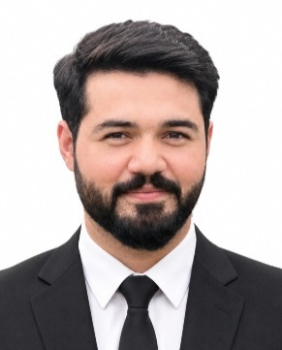

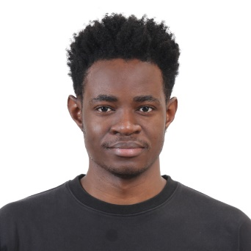





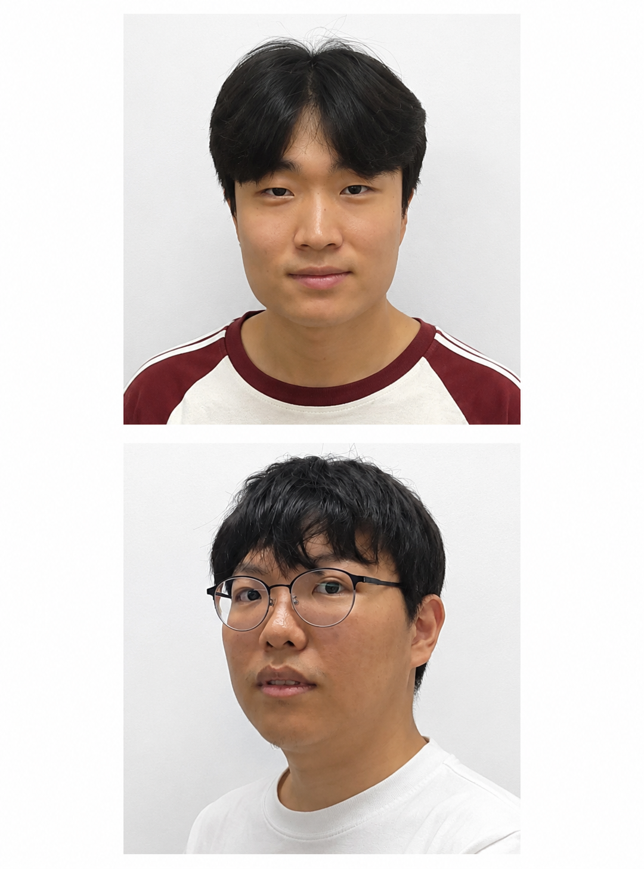

6. Research Team (VIS2KNOW Lab)
Farhan Ahmed
(PhD Fellow, SKKU) (March 2021-now)
Fatma Eid
(PhD Fellow, SKKU), (Fall 2023-now)
Zubayda
(PhD Fellow, SKKU), (Spring 2024-now
Shehzad Ali
(Master-PhD, SKKU), (Spring 2024-now)
MD Tanvir Islam
(Master, SKKU)
(Feb 2023-Aug 2025), PhD, KNU
Muhammad Farooq
(Master, SKKU)
(Sept 2026– Aug 2028)
Bilol
(Master, SKKU)
(Sept 2025-Aug 2027)
Wajahat (TA)
(Master, SKKU)
(March 2026-Feb 2028)
Glody
(Master, SKKU)
(March 2026-Feb 2028)
Asad Ullah
(Master, SKKU)
(Sept 2026– Aug 2028)
JeasonHan
(Master, SKKU)
SeoYoung
(Undergraduate, SKKU)
Haong Kim
(Undergraduate, SKKU)
Byeon Jihwan
(Undergraduate, SKKU)
Nisrine Khnifass
(Exchange student, SKKU)
Kim Jae-Yoon
(Undergraduate, SKKU)
Kim Dong-Yoon
(Undergraduate, SKKU)
13

Slide 14
7. Research Topics
Child Aggression Detection and Analysis
Video Summarization
Disaster Management
Image and Video Retrieval
IoT/IoMT
VIS2KNOW Laboratory
Information
Security
Video Surveillance
Action and Activity Recognition/ Violence Detection
Data
Prioritization
Image Super Resolution/
Dehazing
14

Slide 15
8. Artificial Intelligence (AI)
15

Slide 16
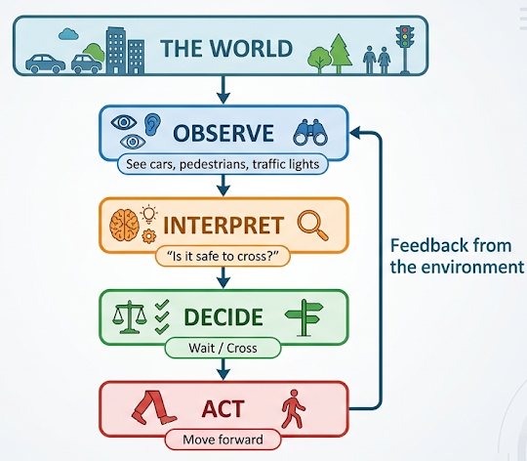
8 (i): Intelligence Starts with the World
Observe
Interpret
Decide
Act
A reasonable question to think on it.
How Do We Make Sense of the World?
Example: A Human Crossing a Road
Observe
See cars, pedestrians, traffic lights
Interpret
“Is it safe to cross?”
Decide
Wait / Cross
Act
Move forward
A person can:
  Recognize a familiar face
  Understand spoken language
  Detect danger
  Learn from experience
  Choose an action
Intelligence begins with using information to understand a situation and make useful decisions.
16

Slide 17
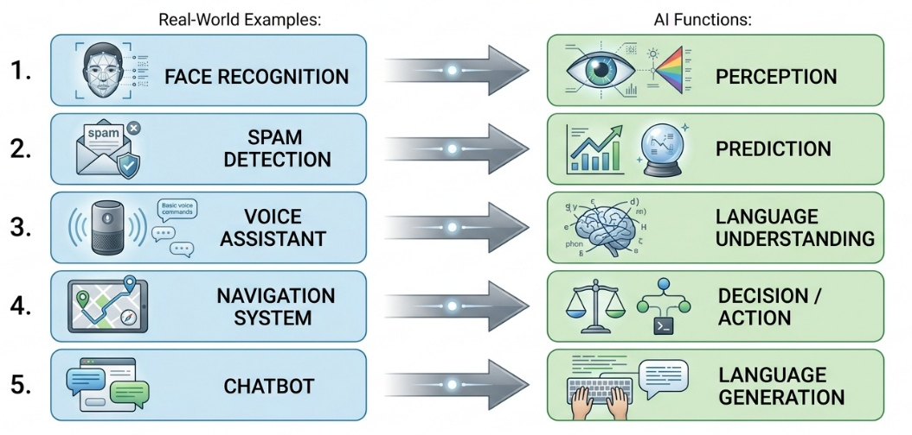

8 (ii): What Is Artificial Intelligence?
Definition:
Artificial Intelligence (AI) is the field of building computational systems that can perform tasks that normally require aspects of human intelligence.
AI can help machines:
Perceive
See and hear the environment
Learn
Learn patterns from data
Understand
Interpret language and information
Reason / predict
Use information to reach conclusions or predictions
Act / generate
Choose actions or produce new content
AI performs specific tasks that involve capabilities associated with intelligence. The example for it is given in the diagram.
17

Slide 18
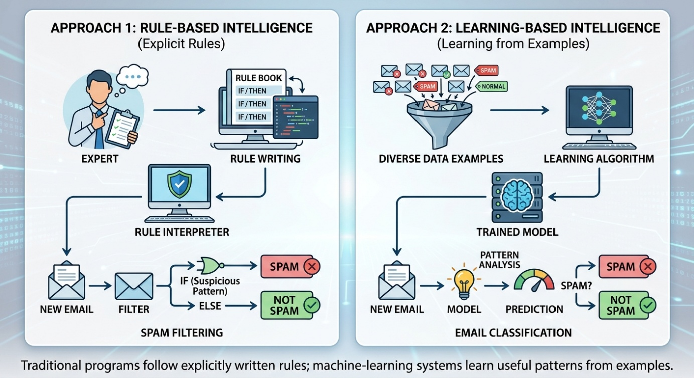
8 (iii): Intelligence in Machines: Rules vs Learning
How Do We Teach a Machine to Solve a Problem?
  We can explicitly program the solution OR we can give the machine examples and let it learn the pattern.
1:Explicit Rules
“Tell me what to do?”
2:Machine Learning
“Show me examples, So I can learn pattern”
Example:1
IF message contains suspicious pattern
↓
SPAM
ELSE
↓
NOT SPAM
Example: 2
Many spam + normal emails
  Learning
  Learned model
  New email → Spam / Not Spam
18

Slide 19
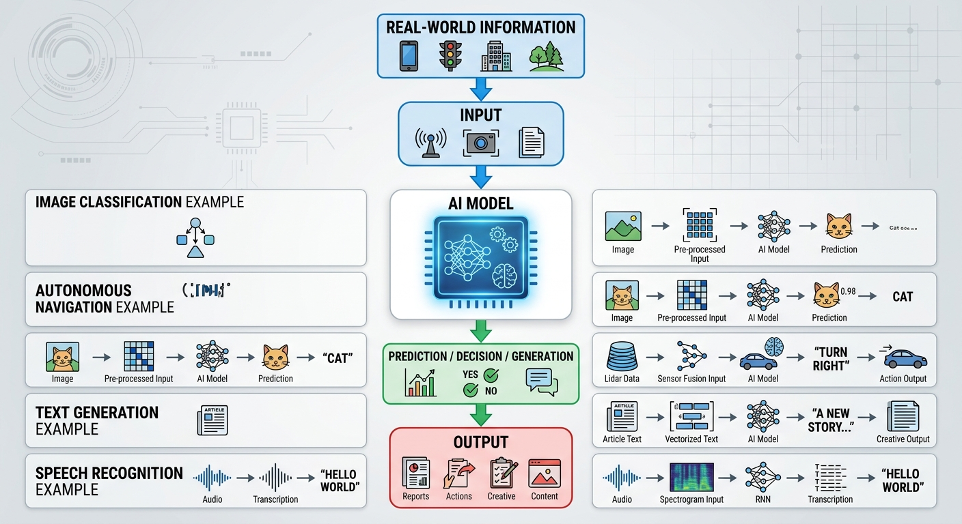
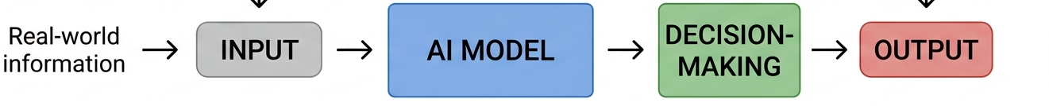
8 (iv): The Basic Idea of an AI System
Basic Idea
Some Visual Examples
An AI system transforms input information into a useful output.
19

Slide 20
9. Multimodal AI
20

Slide 21
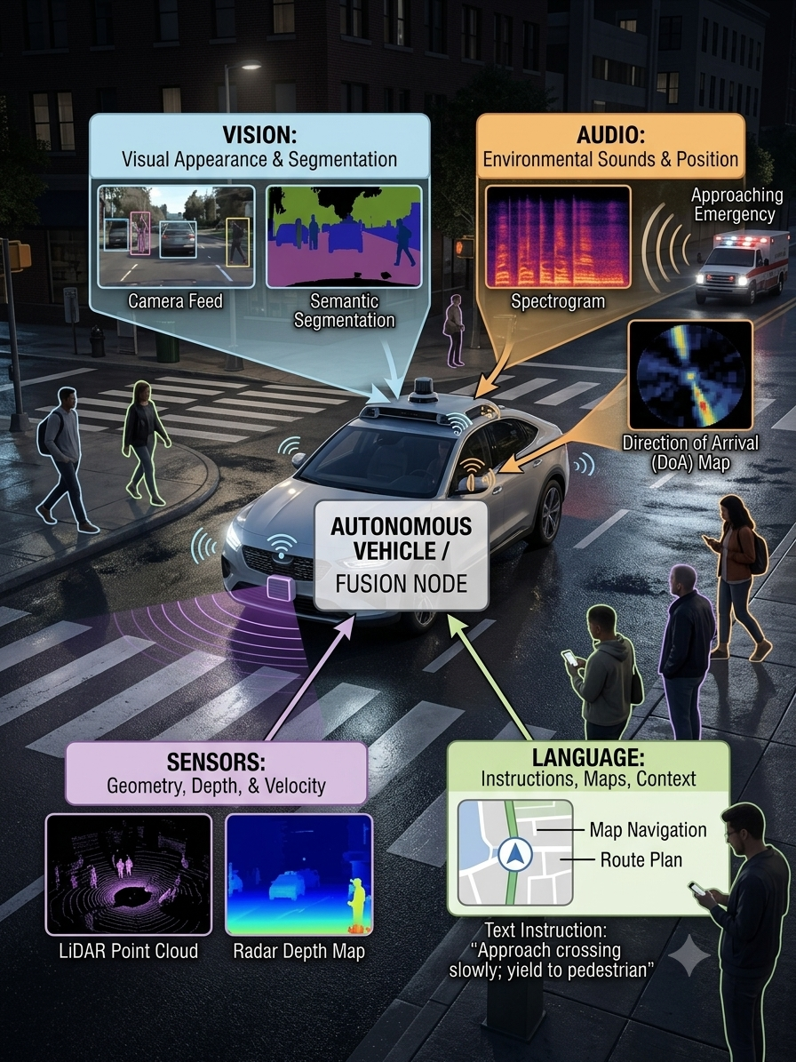
9 (i): The Real-World Problem
One event. Many signals.
Imagine an autonomous vehicle approaching a busy crossing at night.
A single real-world situation generates multiple, complementary (different but useful together) sources of information.
The challenge
Can one information source provide enough evidence to understand the situation reliably?
Real-world intelligence requires combining information that is distributed across different signals.
Think–pair–share
Which signal would you trust most in this situation?
When could that signal fail?
21

Slide 22
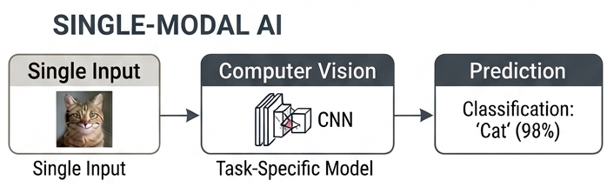
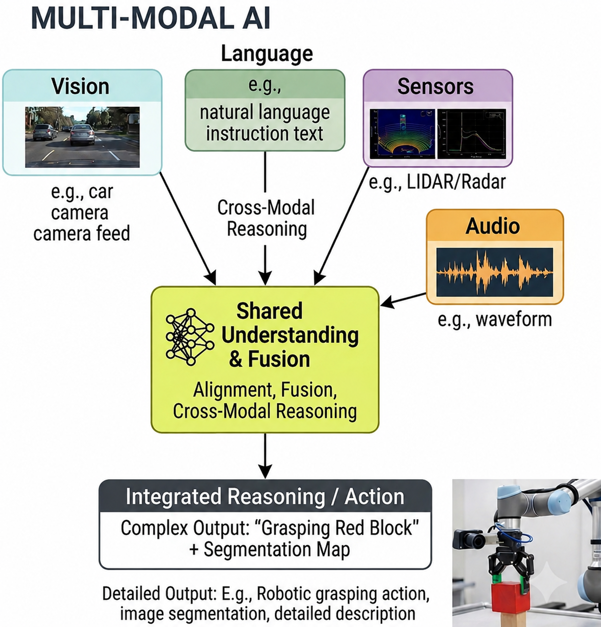
9 (ii): Why Multimodal AI?
The Central Question
  How does intelligence emerge when information comes from multiple sources?
Traditional AI systems often specialize in one information type:
  Computer Vision
  Natural Language Processing
  Speech AI
  Video Understanding
  Sensor AI
But real-world intelligence rarely operates on one source alone.
Key idea
  The real world is multimodal. Intelligent systems therefore need mechanisms for integrating heterogeneous information.
22

Slide 23
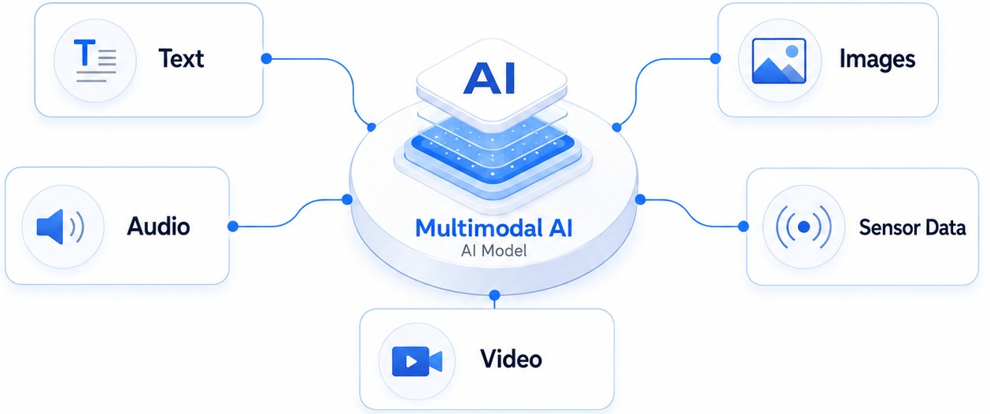
9 (iii): What is Multimodal AI?
Definition:
  Multimodal AI refers to AI systems that can process, represent, connect, and reason over information originating from multiple modalities.
The course plan describes multimodal AI as systems that:
Perceive
Align
Reason
Perceive the information
Align information across sources
Reason over multiple sources
Important distinction
Multimodal AI is not simply putting several AI models together.
The central challenge is:
How can heterogeneous information be represented in a form that allows meaningful interaction between modalities?
23

Slide 24
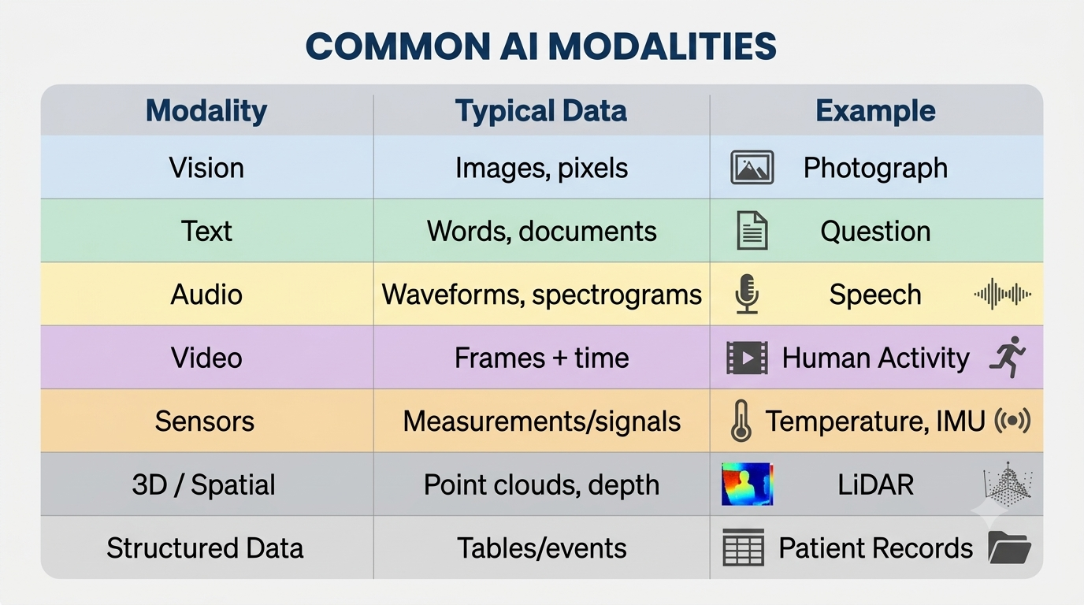
9 (iv): Understanding "Modality"
Modality: A distinct channel or form through which information is represented or observed.
Common AI modalities:
Key insight
Different modalities describe the same world from different information perspectives.
For example:
A person crossing a road
The example is explained on the next slide with visualization.
24
Notes:
Inertial Measurement Unit (IMU) is a sensor that measures an object's motion and orientation. Example: In a smartphone, the IMU can detect whether you tilt the phone, whether you rotate it, whether you are moving etc.

Slide 25
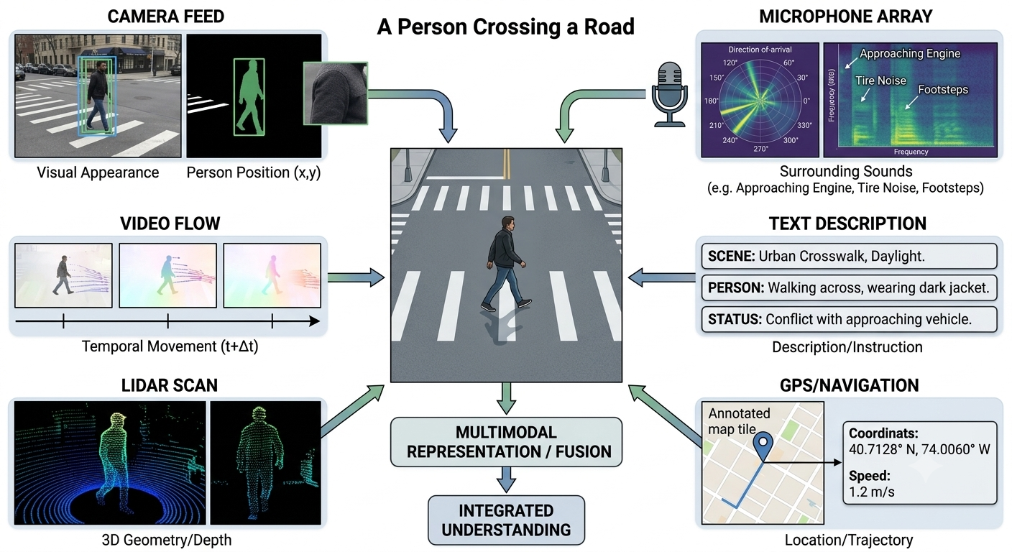
9 (iv): Understanding "Modality“ (Example)
25

Slide 26
9 (v): Why Are Modalities Different?
Different modalities have fundamentally different properties.
Vision
Text
Audio
Video
Sensors
Spatial structure
High-dimensional
Strong local relationships
Rich visual semantics
Sequential / symbolic
Highly semantic
Discrete tokens
Temporal signal
Frequency structure
Prosody and acoustic information (Tone, rhythm, and sound properties)
Spatial + temporal structure
Motion
Long-range temporal dependencies
Continuous/Numerical measurements
Sampling rates
Noise and missing values
Physical-world constraints
The challenge
  A model cannot automatically assume that information represented differently is directly comparable.
This is why multimodal systems require representation learning, alignment, and fusion mechanisms.
26

Slide 27
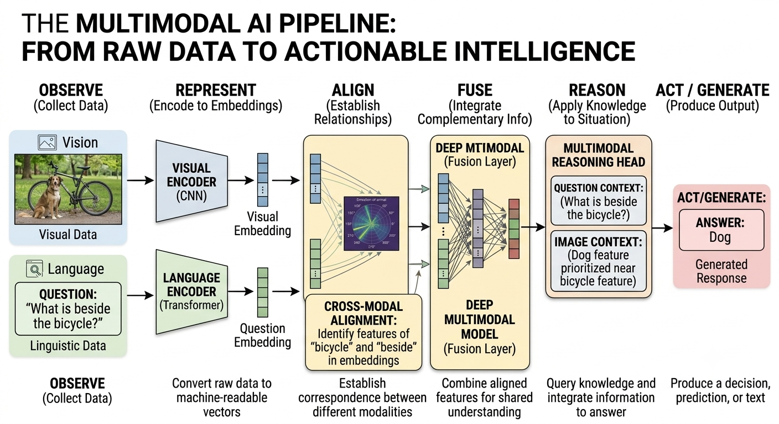
9 (vi): The Multimodal Pipeline
A useful mental model does the following:
Observe
Represent
Align
Fuse
Reason
Act
Example:
Image + question
  Image: a dog sitting beside a bicycle
Question:
"What is beside the bicycle?"
System must:
Image → visual representation
Question → language representation → Alignment → Multimodal reasoning
Answer: Dog
27

Slide 28
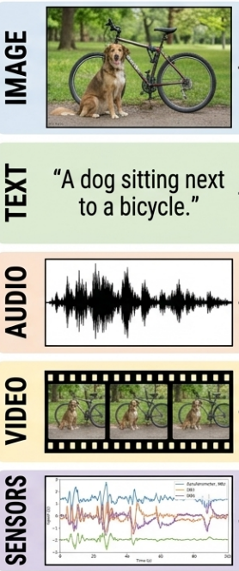

9 (vii): The Three Core Concepts
Concept 1: Representation
How do we represent multimodal data?
  Before different modalities can interact, each must be transformed into a shared computational form.
  Raw inputs are encoded into learned representations (embeddings):
Why representation matters?
Representation is the foundation layer of multimodal learning:
  Without meaningful representations, alignment and fusion are not possible.
It determines how well information from different modalities can later be compared and integrated.
INPUT
Representation
Model
Embedding
28

Slide 29
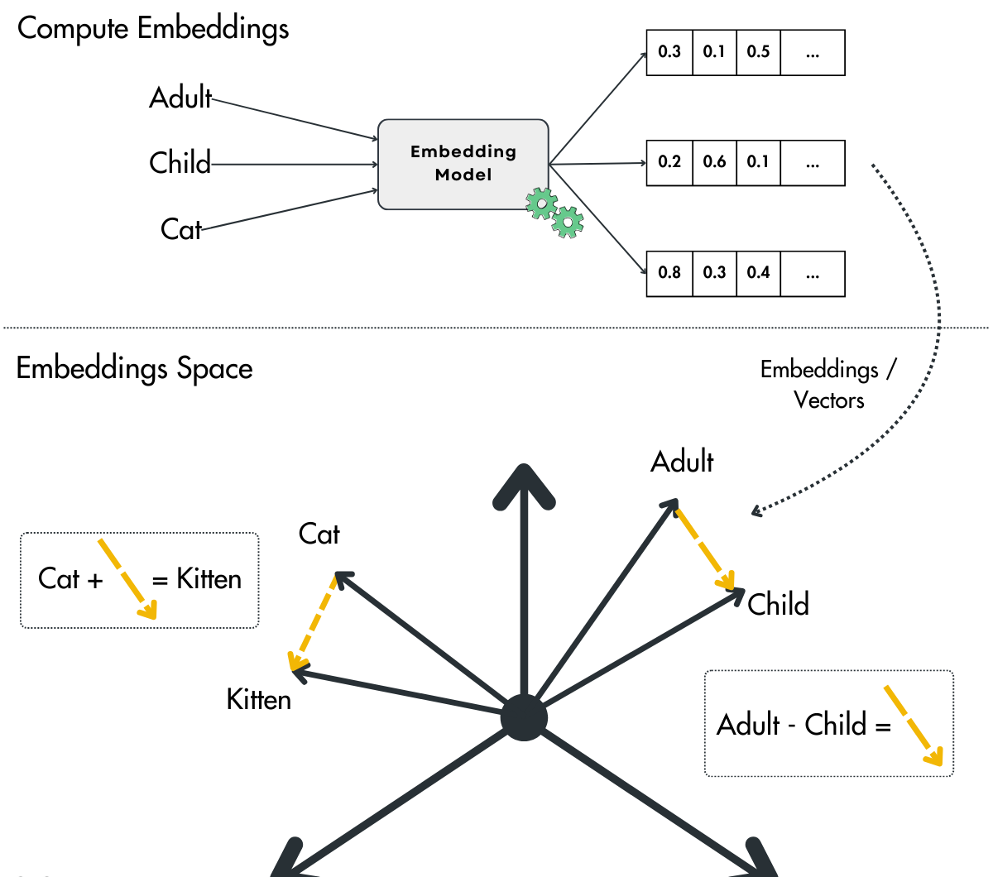
9 (vii): The Three Core Concepts
What is an Embedding?
An embedding is a learned, dense vector representation that maps raw data
into a continuous geometric space where semantic relationships are preserved.
Formally:
  Semantically similar inputs → nearby vectors
  Semantically different inputs → distant vectors
This allows different types of data to be compared and processed in
a unified mathematical space.
Example intuition:
  “cat” (text) → vector
  image of a cat → vector
  sound of a cat → vector
Although these inputs come from different modalities, their embeddings can still be placed close together in the model if they describe the same idea or concept.
When the model learns well, embeddings form an organized “meaning space,” where similar concepts are located near each other, even if they come from different types of data (like text, images, or audio).
29

Slide 30
9 (vii): The Three Core Concepts
Concept 2: Alignment
What is multimodal alignment?
Multimodal alignment is the process of learning correspondences between elements across different modalities.
  It answers:
  What in one modality refers to what in another?
Core idea
Alignment establishes cross-modal correspondence at the semantic or temporal level.
Why is alignment challenging?
Alignment is non-trivial (complex, needing reasoning/effort) because modalities differ in:
  Representation structure (continuous vs discrete)
  Temporal resolution (frame rate vs tokens vs signals)
  Spatial structure (pixels vs sequences vs vectors)
  Noise and missing information
  Level of abstraction (raw signal vs semantic meaning)
Example:
Video ↔ Action
Temporal frames correspond to events (e.g., opening a door)
Key distinction:
Representation defines what each modality is.
“Alignment defines what corresponds across modalities.”
30

Slide 31
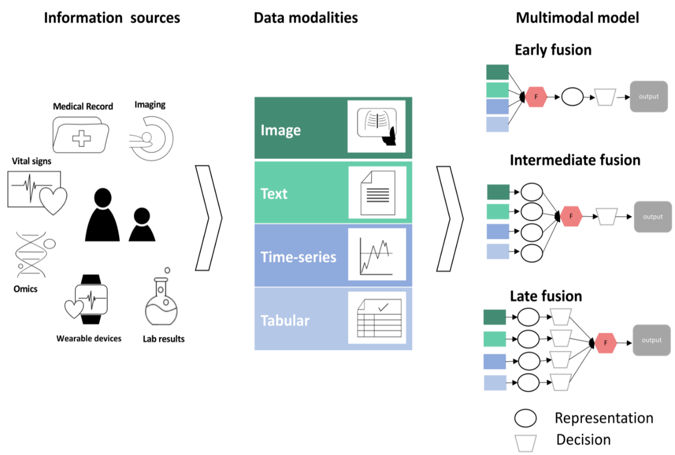
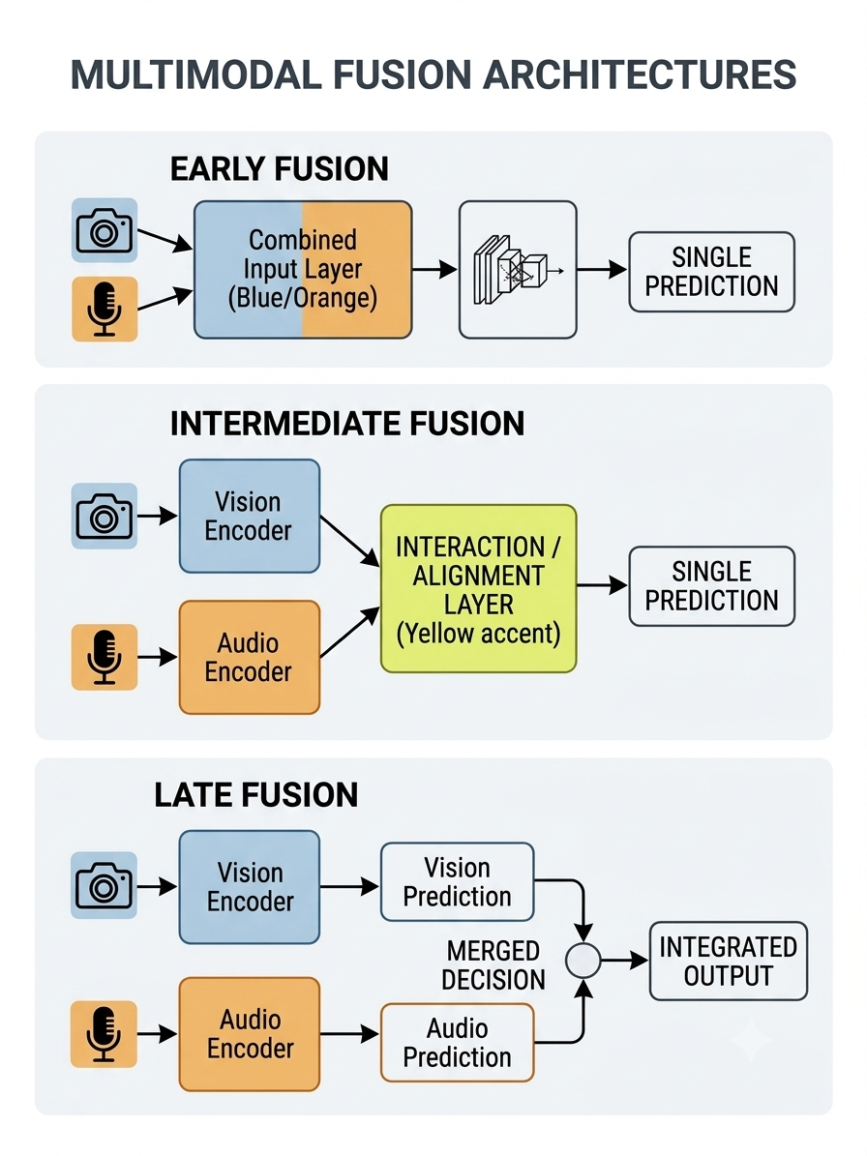
9 (vii): The Three Core Concepts
Concept 3: Fusion
What is multimodal fusion?
Fusion is the process of integrating information from multiple modalities into a unified representation or decision space.
It answers:
How should aligned information be combined for reasoning or prediction?
Types of fusion
Early Fusion (Input-level integration)
  Raw or low-level features are combined before deep processing.
  Image features + text features → joint input representation
    ✔ Simple
    ✖ Limited modality-specific processing
31

Slide 32
9 (vii): The Three Core Concepts
2. Intermediate Fusion (Representation-level interaction)
  Each modality is encoded separately, then combined through interaction layers.
  Vision encoder + Language encoder → cross-modal attention / interaction
    ✔ Most widely used in modern multimodal models
    ✔ Preserves modality-specific structure
3. Late Fusion (Decision-level integration)
  Each modality produces independent predictions, which are then combined.
  Vision prediction + Audio prediction → final decision
    ✔ Robust to missing modalities
    ✖ Limited deep interaction
Key principle
Fusion is most effective when modalities provide:
Complementary information (different aspects of same event)
Redundant information (confirmation across sources)
Contextual information (one modality disambiguates another)
32
Notes:
Example 1: Image Disambiguates Text
The Ambiguous Modality (Text): You see a text message that says: "Look at that crane!"
The Problem: The word "crane" could mean a large bird, a construction machine, or stretching your neck. You cannot tell which one it is from the text alone.
The Disambiguating Modality (Image): Right next to the text, there is a photo of a construction site with a massive metal machine.
The Result: The image instantly disambiguates the text. It eliminates the bird and neck-stretching options, leaving only the correct meaning.
Example 2: Text/Audio Disambiguates Video
The Ambiguous Modality (Video): You watch a silent, close-up video clip of a person crying.
The Problem: You do not know if they are crying from intense sadness, intense joy (winning an award), or simply cutting up an onion.
The Disambiguating Modality (Audio): The audio track is added, and you hear the person yell, "Oh my god, I won!"
The Result: The audio disambiguates the video, clearing up the confusion so you know the tears represent happiness.

Slide 33
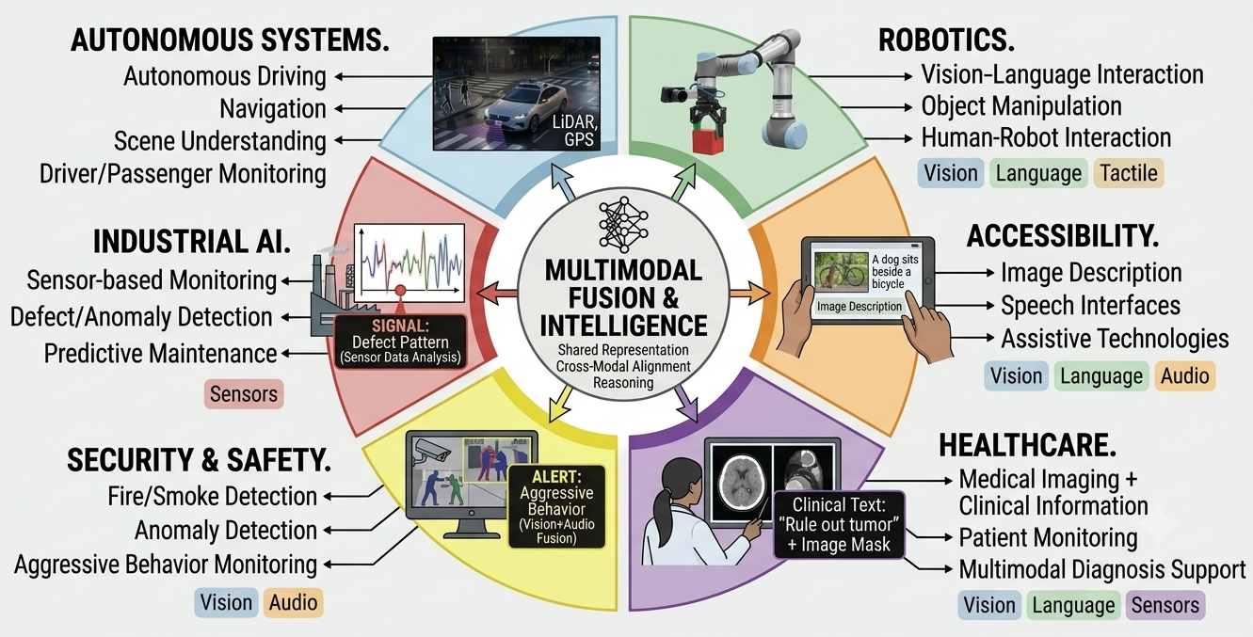
9 (viii): Application Landscape
Where Is Multimodal AI Used?
Multimodal AI spans multiple real-world domains.
33

Slide 34
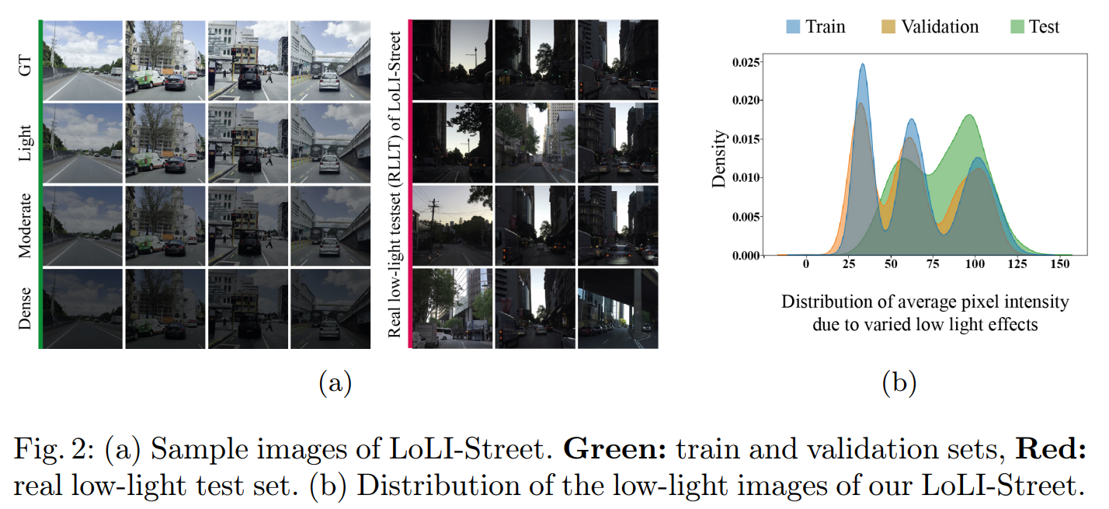
9 (ix): Course Case Studies
From Theory to Real Systems
The course is structured to bridge foundational multimodal AI theory with real-world intelligent systems deployed in perception, monitoring, and decision-making tasks.
Each case study represents a progression in system complexity — from low-level perception to high-level reasoning and action.
LOW-LEVEL PERCEPTION SYSTEMS:
  Image Enhancement & Restoration
  Focus:
  Improving visual quality and signal fidelity
  Noise removal, deblurring, and reconstruction
  Foundational step for all vision-based AI systems
LoLI-Street: Benchmarking Low-Light Image Enhancement and Beyond, The 17th Asian Conference on Computer Vision (ACCV), 2024, Hanoi, Vietnam. BK IF=1.
34

Slide 35
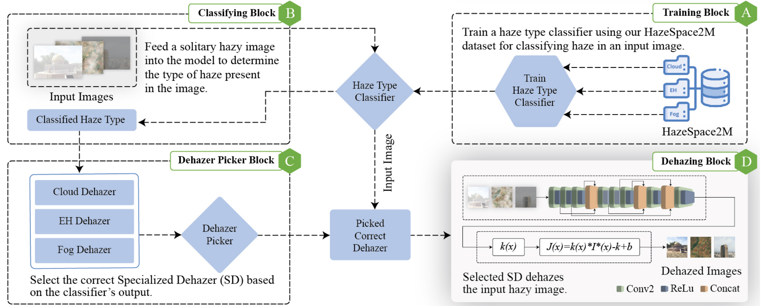
9 (ix): Course Case Studies
From Theory to Real Systems
LOW-LEVEL PERCEPTION SYSTEMS:
Image Enhancement & Restoration
Haze-Aware Image Dehazing
Fig. 2: Our proposed framework for haze-aware single-image dehazing using specialized dehazers.
Dataset: HazeSpace2M
A large-scale paired dehazing dataset
Features over 2 million hazy images
Key Features
Features four different scene types
Includes three different haze types
35

Slide 36
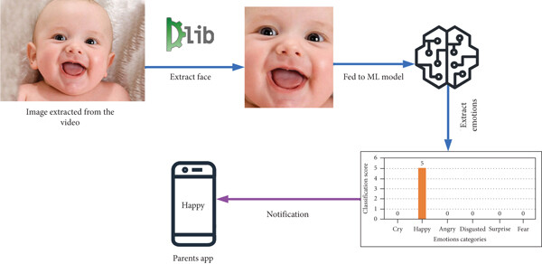
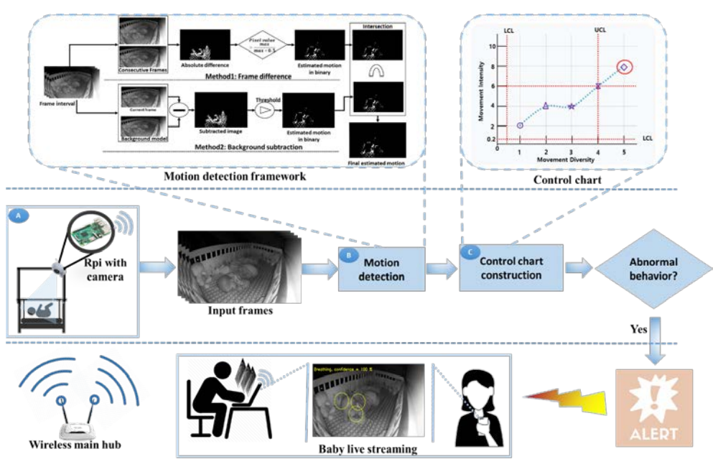
Course Case Studies: From Theory to Real Systems
ENVIRONMENTAL UNDERSTANDING SYSTEMS
  Intelligent Baby Monitoring
  Focus:
  Continuous multimodal scene understanding
  Detection of activity patterns and anomalies
  Early-stage event recognition in dynamic environments
Proposed baby behaviour monitoring framework. (A): Input is acquired from smart camera attached to RPi, (B): motion computation where two different algorithms are executed to compute motion of baby, and (C): control chart construction from the detected motion, abnormal breathing behaviour detection based on one interval of control chart, and alert transmission in case of any abnormal breathing or motion behaviour.
Hussain, T., Muhammad, K., Khan, S., Ullah, A., Lee, M. Y., & Baik, S. W. (2019). Intelligent baby behavior monitoring using embedded vision in IoT for smart healthcare centers. Journal of Artificial Intelligence and Systems, 1(1), 110-124.
36

Slide 37
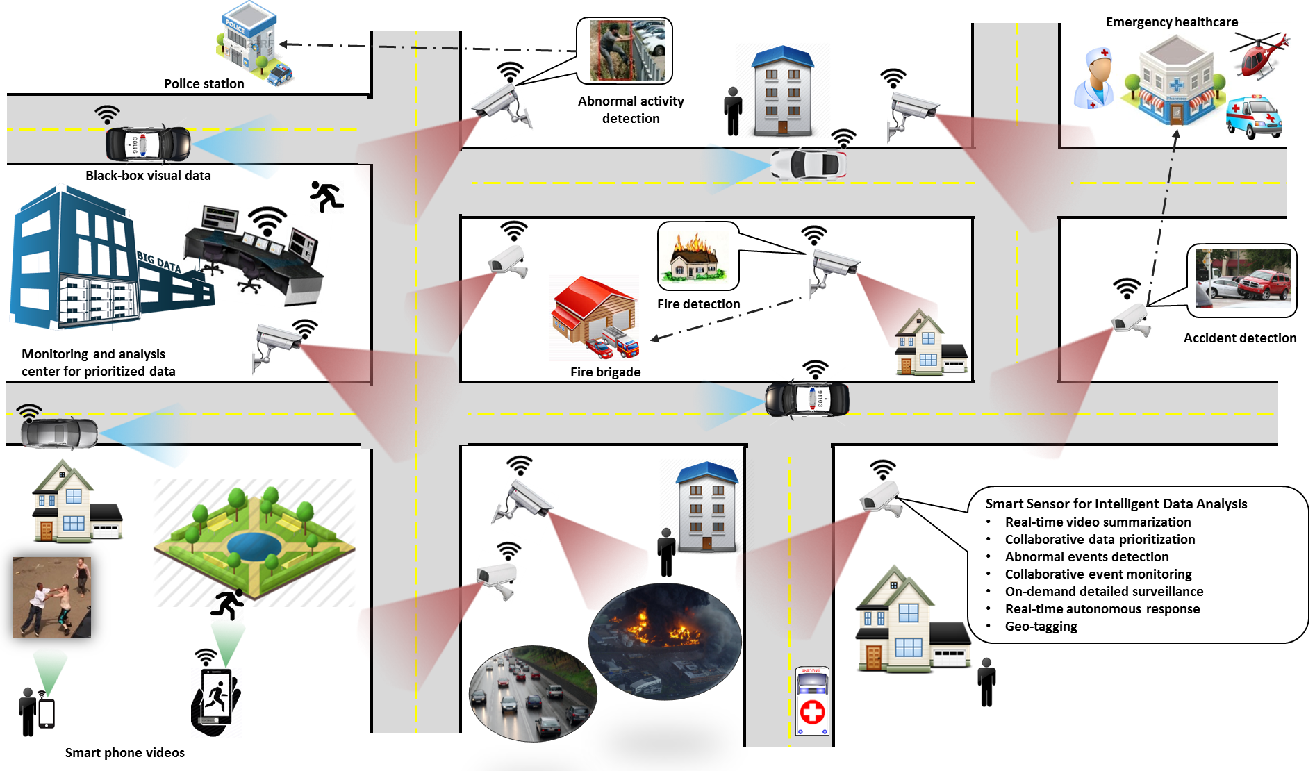
Course Case Studies: From Theory to Real Systems
ENVIRONMENTAL UNDERSTANDING SYSTEMS
Intelligent Baby Monitoring
Fire & Smoke Detection
Focus:
Real-time scene interpretation
Safety-critical visual recognition
Early warning through visual
cues and environmental signals
37

Slide 38
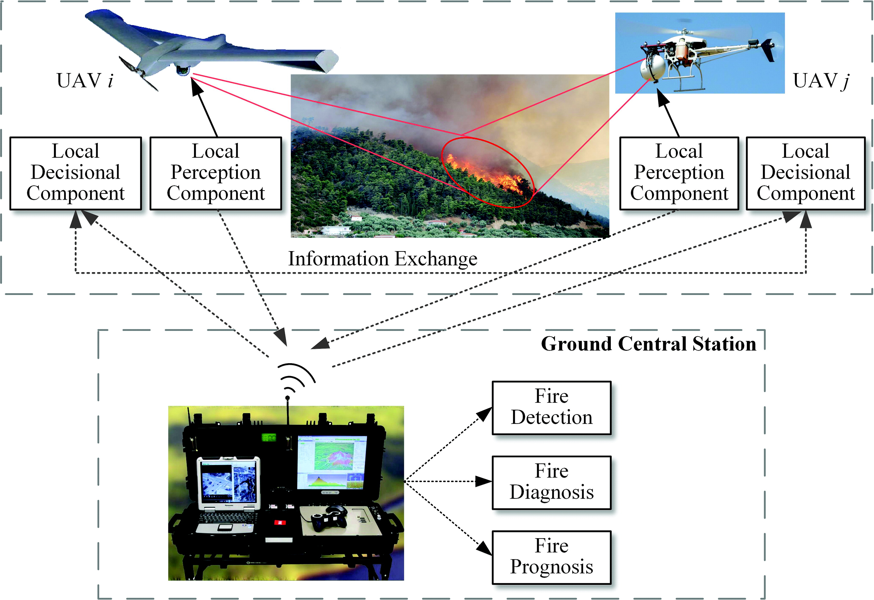
Course Case Studies: From Theory to Real Systems
ENVIRONMENTAL UNDERSTANDING SYSTEMS
  Intelligent Baby Monitoring
  Fire & Smoke Detection
  Focus:
  Real-time scene interpretation
  Safety-critical visual recognition
  Early warning through visual cues and environmental signals
38

Slide 39
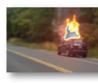
Course Case Studies: From Theory to Real Systems
AGENTIC & DECISION-ORIENTED SYSTEMS
Agent-Based Fire Monitoring
Focus:
Autonomous monitoring agents
Continuous perception–decision loops
Integration of perception with response strategies
Collaborative monitoring of fire scene through agents
Report instantly (No. 2)
Agent 4
Person detection and counting
Report instantly (No. 1)
Report instantly
(No. 5 and No. 8b)
Agent 6
Object detection
and recognition
Agent 1
Feature extraction and classification
Agent 3
Objects localization and distribution
Agent 8
Evacuation
monitoring
Report instantly
(No. 3)
Input video data
Agent 7
Object type
recognition
Report instantly (No. 8a)
Report instantly (No. 4)
Muhammad, Khan, et al. "Energy-efficient monitoring of fire scenes for intelligent networks." Ieee Network 34.3 (2020): 108-115.
Agent 2
Fire expansion
monitoring
Agent 5
Flammable material recognition
39

Slide 40
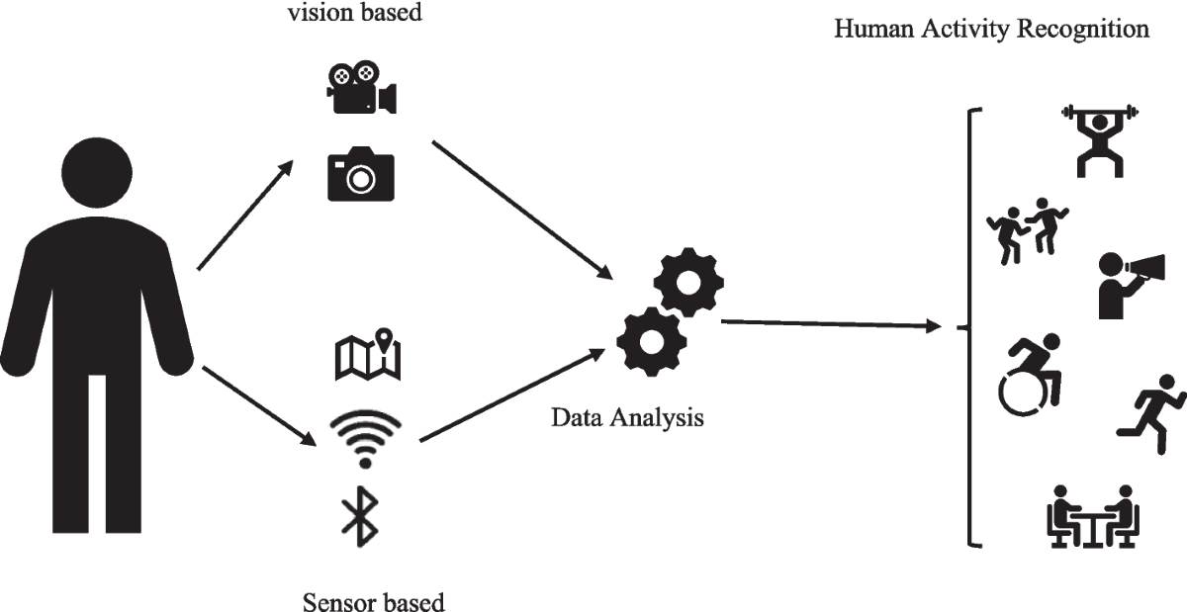
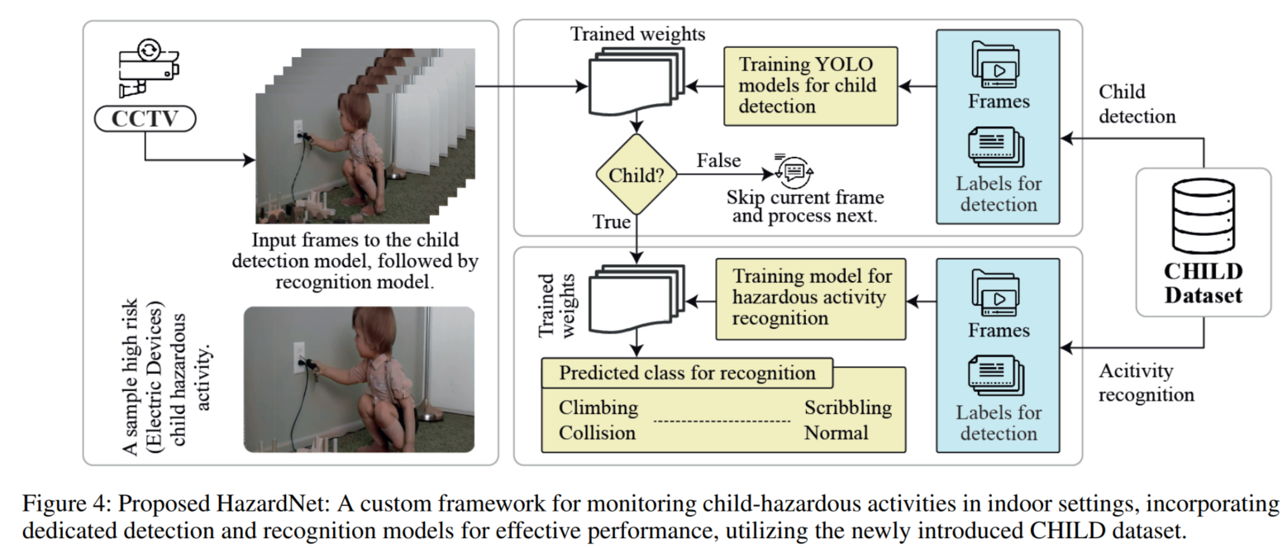
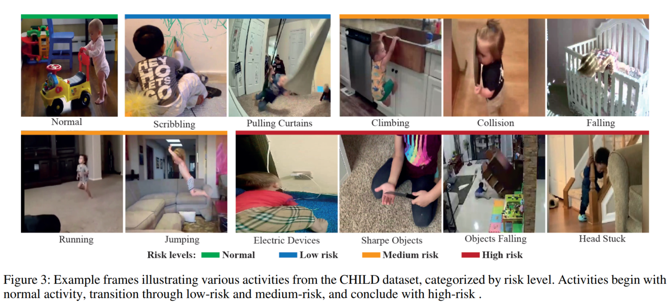
Course Case Studies: From Theory to Real Systems
BEHAVIOR & HUMAN ACTIVITY INTELLIGENCE
  Human Action Recognition
  Focus:
  Understanding structured human motion patterns
  Temporal modeling of behavior
  Multimodal sensor-based interpretation
CHILD: Child Hazardous Indoor Labeled Dataset
for Activity Recognition
ACM Multimedia, 2025, BK IF=4. https://dl.acm.org/doi/abs/10.1145/3746027.3754795
40

Slide 41
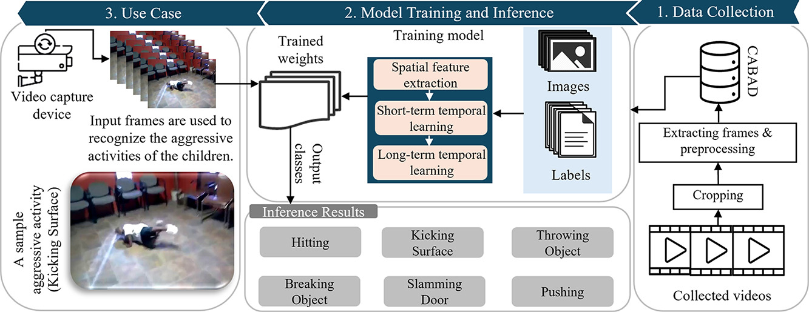
Course Case Studies: From Theory to Real Systems
BEHAVIOR & HUMAN ACTIVITY INTELLIGENCE
Human Action Recognition
Aggressive Behavior Monitoring
Focus:
Complex behavior classification in real environments
Context-aware interpretation of human actions
Safety and surveillance applications
CABAD: A Video Dataset for Benchmarking Child Aggression Recognition
Alexandria Engineering Journal (Impact Factor: 6.2, Q1 Rank, Top 5%)
Child Aggression Behavior Analysis Dataset (CABAD) and CABA_Net
41

Slide 42
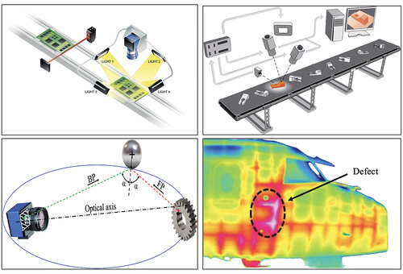
Course Case Studies: From Theory to Real Systems
BEHAVIOR & HUMAN ACTIVITY INTELLIGENCE
INDUSTRIAL INTELLIGENCE SYSTEMS
Industrial Anomaly Detection
Focus:
Detection of deviations in operational systems
Multisensor pattern analysis
Predictive monitoring for system reliability
42

Slide 43
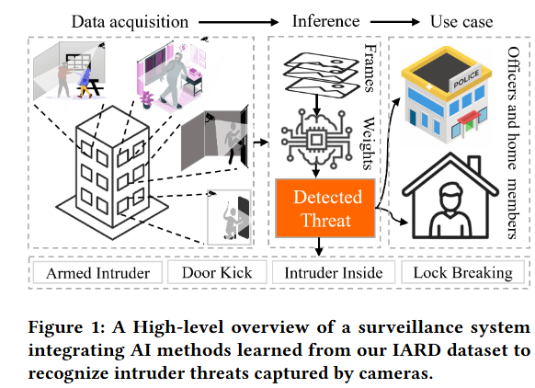
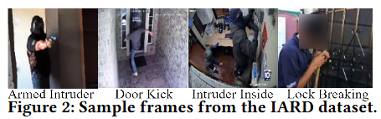
Course Case Studies: From Theory to Real Systems
IARD: Intruder Activity Recognition Dataset for Threat Detection
The 34th ACM Conference on Information and Knowledge Management (CIKM), COEX, Seoul, 2025, BK IF=3.
43

Slide 44
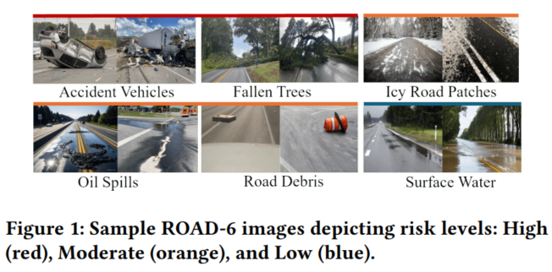
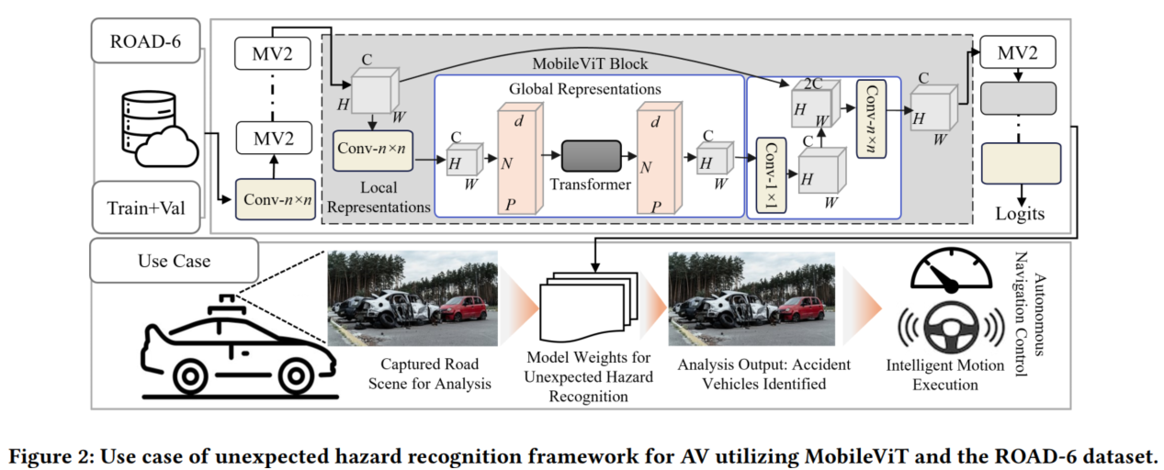
Course Case Studies: From Theory to Real Systems
ROAD-6: A Diverse Dataset for Unexpected Hazard Recognition in Autonomous Vehicles
The 15th ACM International Conference on Multimedia Retrieval (ICMR), USA. BK IF=1.
44

Slide 45
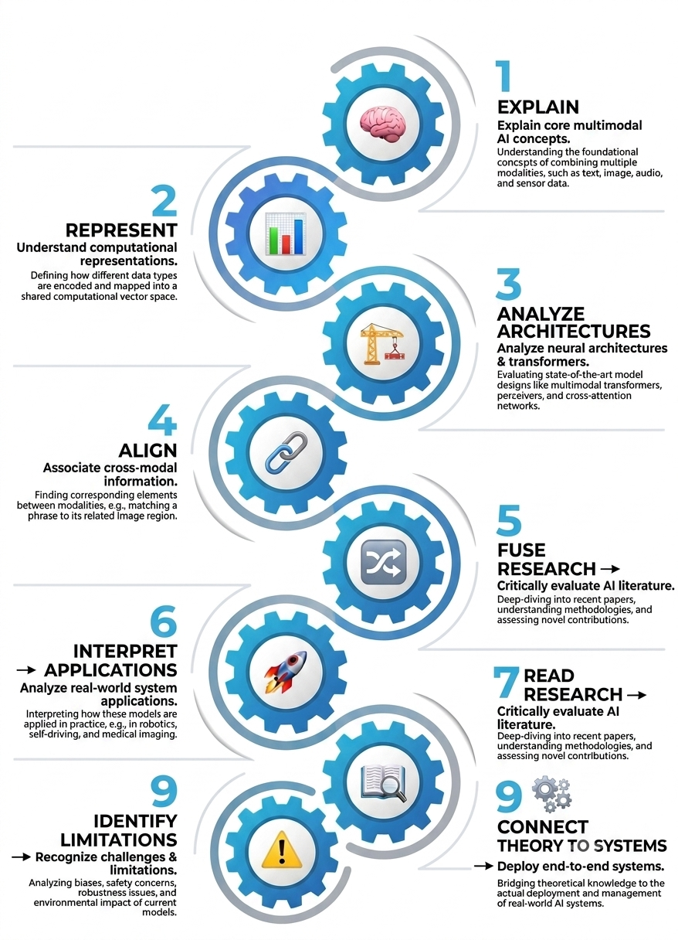
9 (x): Course Learning Outcomes
5. Analyze architectures
Understand the role of neural networks, embeddings, attention, and Transformers in multimodal systems.
1. Explain
Explain the fundamental concepts behind multimodal AI.
7. Reading Literature
Understand and critically discuss multimodal AI research papers and case studies.
3. Align
Explain how information from different modalities can be associated and aligned.
By the end of the course, students should be able to understand these
2. Represent
Understand how different modalities are represented computationally.
4. Fuse
Understand major strategies for combining multimodal information.
6. Interpret applications
Analyze how multimodal AI is used in vision, audio, video, sensors, robotics, healthcare, autonomous systems, and safety applications.
8. Identify limitations
Recognize challenges such as noise, missing modalities, alignment errors, computational cost, bias, and reliability.
45

Slide 46
9 (xi): Course Roadmap
Phase 2 Vision & Real-World Perception
Phase: 1 Foundations
Week 1
Introduction to Multimodal AI
Week 2
Deep Learning Foundations
Attention & Transformers as the Multimodal Backbone
Week 3
Week 5
  Low-Level Vision & Image Enhancement
Week 6
  Intelligent Baby Monitoring
Week 7
Fire/Smoke Detection & Scene Analysis
Week 8
Mid Term Exam
Week 4
  Vision: CNNs → Vision Transformers
46

Slide 47
9 (xi): Course Roadmap
Phase 3 Intelligent Multimodal Systems
Phase 4 Beyond Vision
Week 9
Agent-Based Intelligent Fire Monitoring
Week 10
Vision-Language Alignment & Open Vocabulary Object Detection
Audio & Speech
Week 11
Week 12
Video Understanding
Week 13
Industrial Anomaly Detection
Week 14
Sensor-Based Human Action Recognition
Aggressive Behavior Monitoring
Week 15
Week 16
Final Term
47

Slide 48
9 (xi): Course Roadmap
8. Goals and Expectations
Professor’s Topics of Research
Keynote Talk
  Keynote Speaker, The 25th International Conference on Computational Science and Its Applications, Turkey, 2025
Intelligent Fire Scene Analysis
  Exposure of Area
  Thesis Tips
Students’ Presentation
  Topic and Contributions
  Plan and Suggestions
Invited Speakers
  Success Story and Experiences
  Projects
  Opportunities
48

Slide 49
10: Goals and Expectations
8. Goals and Expectations
My goals
  Maximize the learning effectiveness of your time
  Provide roadmap for further exposure to related research areas
  Ensure good grade with hard work, flexibility, and equality
My expectations from you
  Attend and participate, when possible
  Follow up the lecture (if missed)
  Start assignments/homework/project etc. well before the deadline
  Stay tuned on the i-Campus
  Feedback about what’s working for you and suggest improvements
    You can write in an email
    You can submit anonymously
    Use official week 1, mid-term and final-term evaluations
49

Slide 50
11: Assignment/Project/Presentation
8. Goals and Expectations
Dataset Creation and Benchmarking
Instructions
  Total Marks: 15~30
  Each student will do the assignment alone/group.
  Due date for dataset theme selection to avoid duplication (use khanmuhammad@g.skku.edu as usual): X 2026
  Due date for submission of all details of the assignment/project/presentation: XX 2026
Task: Each student/team is required to make a comprehensive plan of a new dataset, including its title, main description of the dataset, number of classes, images count and a table listing existing datasets with their key information and details of the new dataset, showing how the new dataset is different and unique etc. You can include all possible details. I will explain via example in the class or using a separate video. The evaluation will be done based on these points:
1. Dataset Understanding & Problem Analysis (5~10 points)
2. Novel Dataset / Extension Proposal (5~10 points)
3. Practical Demonstration/Feasibility (5~10 points)
  Option A (Coding track): run a prototype experiment, test a model, do possible ablation and report results.
  Option B (Non-coding track): provide a feasibility analysis, workflow diagram, collection plan, and manual annotation sample for the dataset you are proposing.
  Option C: Create a small/mini dataset (what is proposed in point 2)
All details can be finalized once the final numbers of students are confirmed.
50

Slide 51
Thank You
Any Question?
Feel free to contact on khanmuhammad@g.skku.edu
Welcome to Join!

